Slide 1
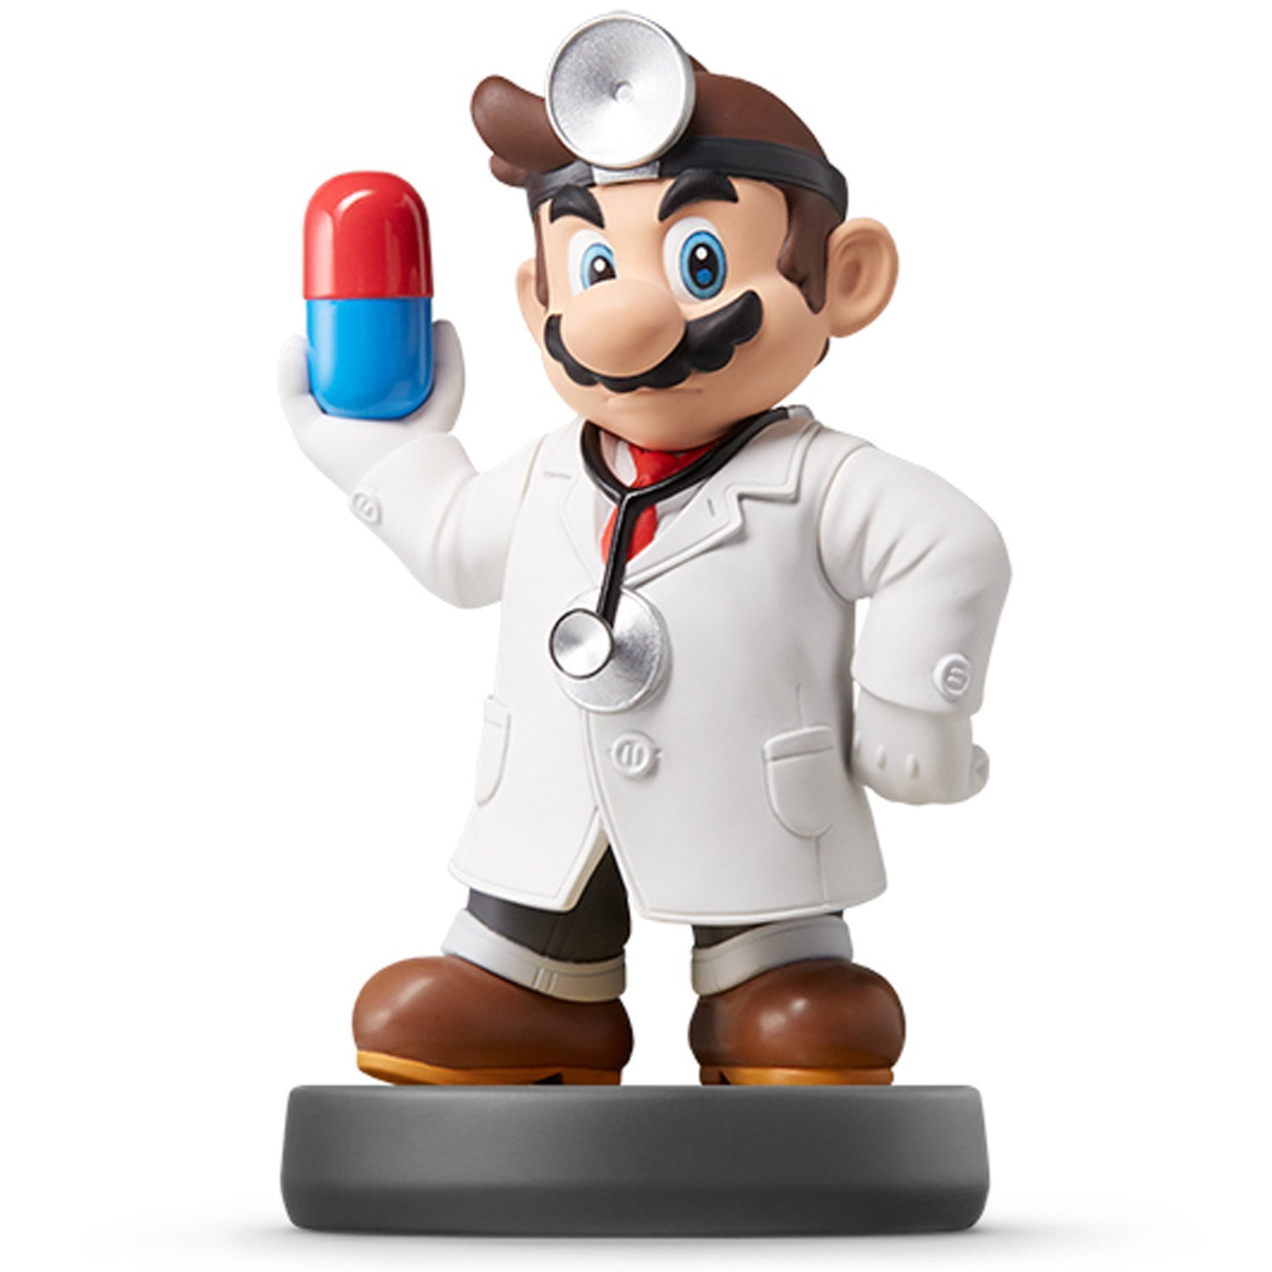
Final Project II

Slide 2
Currently
What You Should Have?
A Data Set
Exploration of Data From Multiple Angles
Preliminary Visuals or Tables
Detailed Follow-up Questions
Investigation on Those Follow-Up Question
Final Steps
Narrow Down All Work to Two Questions of Interest
Build Multiple Models to Answer those Questions
Evaluate and Compare Models

Slide 3
Currently
Presentation and Paper
Highly Related
All Group Members Should Be Involved in Both Parts
Advice
Paper Presentation
Presentation Paper
Feel Free to Notify Me if…
A Member has Dropped
A Member has Avoided Work
A Member has Been Utterly Useless
Full Privacy in Email

Slide 4
Part 4 Final Paper
Intentionally Going Backwards
Rmarkdown Template Included
Parts of the Paper
Introduction

Slide 5
Part 3 Final Presentation
Select

Slide 6
Closing
Disperse and Make Reasonable Decisions

